Slide 1
TEAM 101
Saif Ali
Othiraja
Jai Sachin
Aditya Rai
Adithya kumar

Slide 2

Dataset Provided
Our target audience is bike sharing customers, company stakeholders, city authorities, academics, data related profesionals. BackgroundHubway is a bicycle sharing system in the Boston City area. Since its launch in 2001, Hubway has grown to more than 140 stations and more than 1300 bikes. In 2013, Hubway in parternship with the Metropolitan Area Planning Council, released data from more than a half million trips that were taken on Hubway bikes between its launch on July 28, 2011 until the end of September 2012. In 2018, Hubway was rebranded as Blue Bikes.

Slide 3
Parameters given
The hubway trip history data includes:
Trip duration (in seconds)
Start time and date
Stop time and date
Start station Name and ID
End station Name and ID
Bike ID User type
casual = single trip or day pass user
member = annual or monthly membership (unlimited use) Birth Year
Gender (optional for members, not asked for casuals)

Slide 4
What is EDA?
EDA stands for “Exploratory Data Analysis.” It is an important initial step in the data analysis process, where data analysts and data scientists examine and summarize key characteristics of a dataset. The primary goals of EDA are to understand the data, discover patterns, identify anomalies, and generate hypotheses for further analysis.

Slide 5
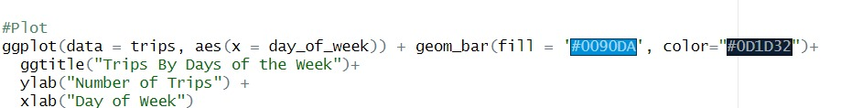
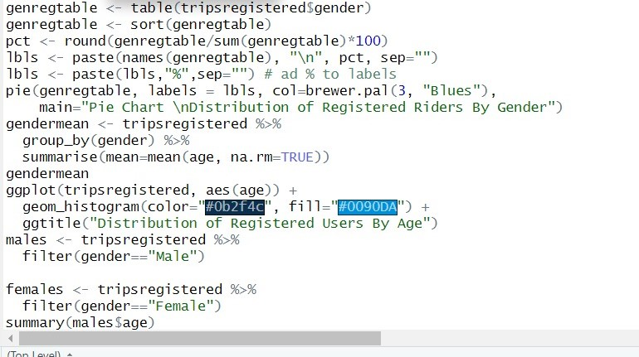
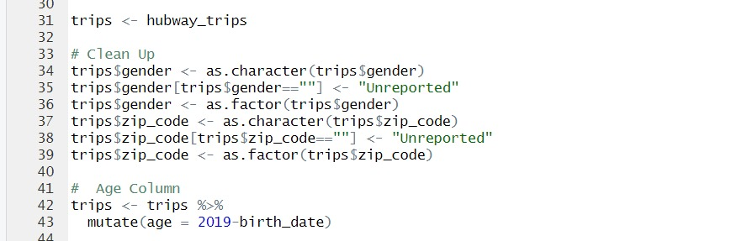
Work Done on EDA

Slide 6
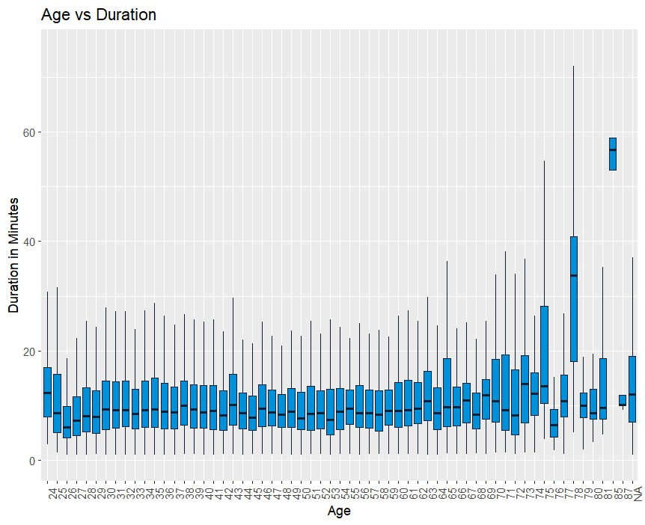
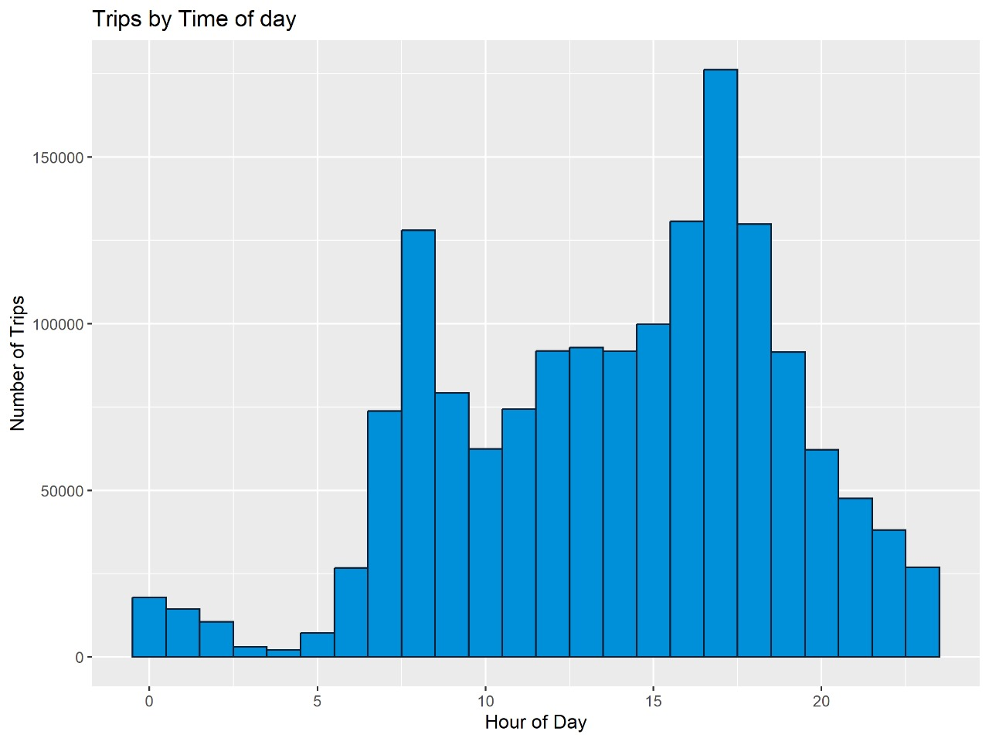
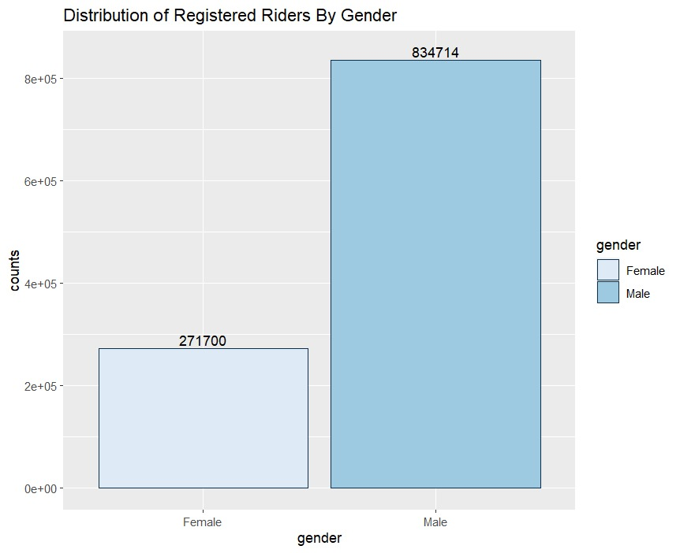
OUR EDA RESULTS

Slide 7
OUR EDA RESULTS

Slide 8
OUR EDA RESULTS

Slide 9
OUR EDA RESULTS

Slide 10
ML MODEL
Random Forest is a machine learning algorithm that constructs multiple decision trees during training. Each tree is built on a random subset of the training data and features, promoting diversity among the trees. When making predictions, the algorithm combines the outputs of these trees through voting (for classification) or averaging (for regression), resulting in a robust and accurate final prediction. This ensemble approach helps mitigate overfitting and improves generalization performance, making Random Forest a popular choice for various machine learning tasks, including classification and regression, especially when dealing with high-dimensional or noisy datasets.

Slide 11
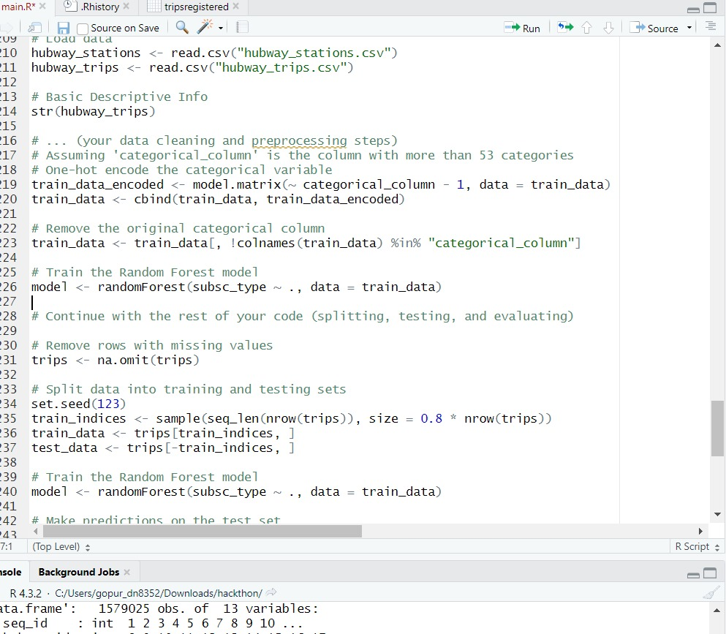
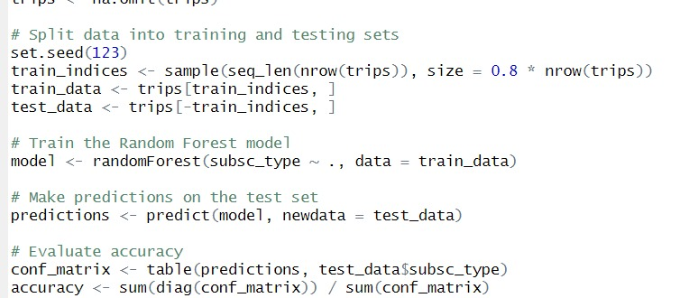
Work Done on ML Model

Slide 12
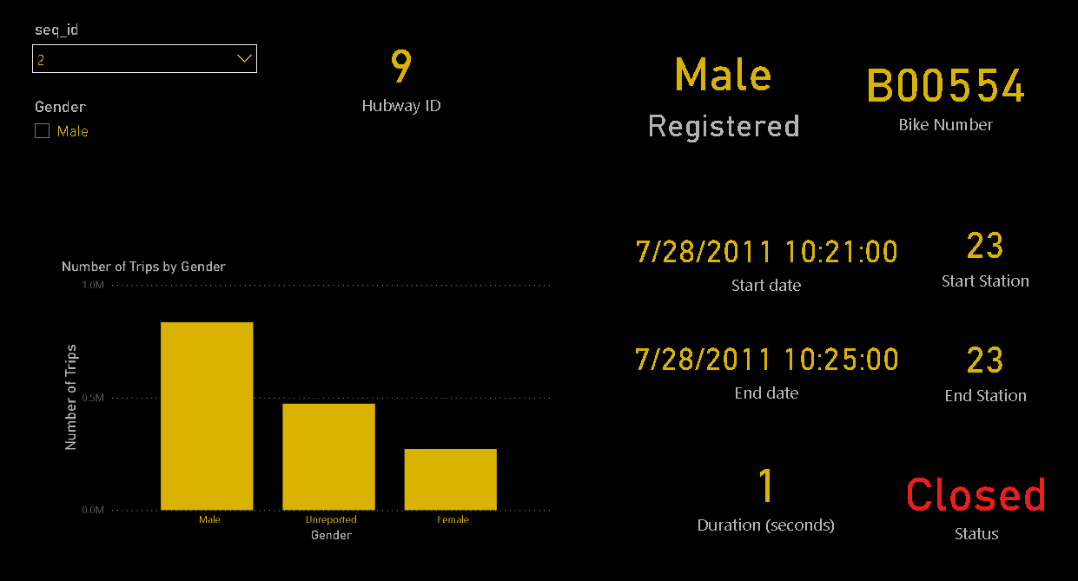
Representation in PowerBi

Slide 13
ACCURACY – 97.6%
OUR INSIGHTS
Station 22 – Major Transportation Hub
Station 36 – Boston public Library
Station 53 – Nearest station to Boston University
Station 67 – Nearest station to MIT
Station 16 – Major Transportation Hub
Station 42 – Boston Garden & Arrington st. church

Slide 14
THANK YOU

